Slide 1
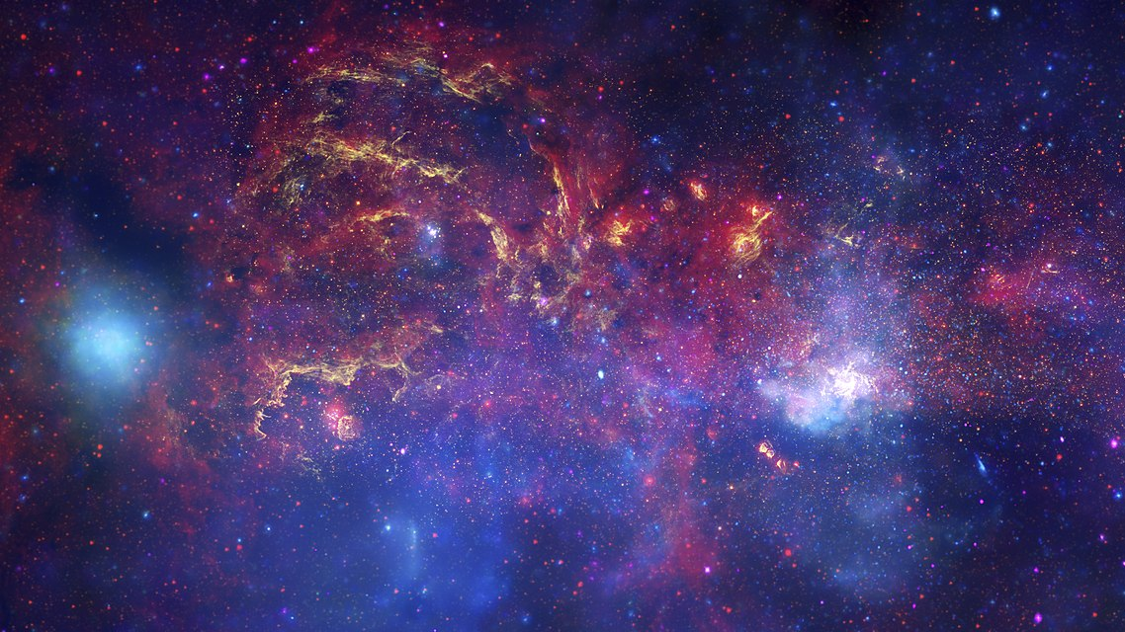
AI from Space using Azure
Christos Charmatzis
@christoscharmatzis
https://tageoforce.com
Center of the Milky Way Galaxy
Source: Wikipedia
Notes:
Welcome to the 1st Global AI Bootcamp 2019 in Athens.
Title of the presentation is “AI from Space using Azure”.
I am Christos Charmatzis and this is the center of our galaxy as the Hubble Space Telescope, the Spitzer Space Telescope, and the Chandra X-ray Observatory have producted.
[click]

Slide 2
Agenda
Few things about me
Introduction to AI
Earth Observation Data and where to find them
Choosing the right way with the right tools
Going to Azure for full power
Conclusions

Slide 3

Few things about me
Project manager @TA-Geoforce
GIS Specialist 10+ years
AI professional
Open Source enthusiasm
Piano player
Chopin – Heroic Polonaise
Source: youtube.com/Rouseau

Slide 4
What they show us
A.I. is here
(I guess…)
Statistics
Data
Technology
Notes:
We all have here this so many times from so many people,
( I tell that because it’s nice to remember the high skills that we Data Scientists have!!!!)
that if we have 3 sets (circles) which are Data, Statistics and Technology
[click]
AI is the common space between them.
[click]
I guess and I say I guess because now days AI is more a brand name, that a scientific definition.
[click]

Slide 5
What’s AI for me
AI Knowledge
Data
All of us
Notes:
We all have here this so many times from so many people,
( I tell that because it’s nice to remember the high skills that we Data Scientists have!!!!)
that if we have 3 sets (circles) which are Data, Statistics and Technology
[click]
AI is the common space between them.
[click]
I guess and I say I guess because now days AI is more a brand name, that a scientific definition.
[click]

Slide 6
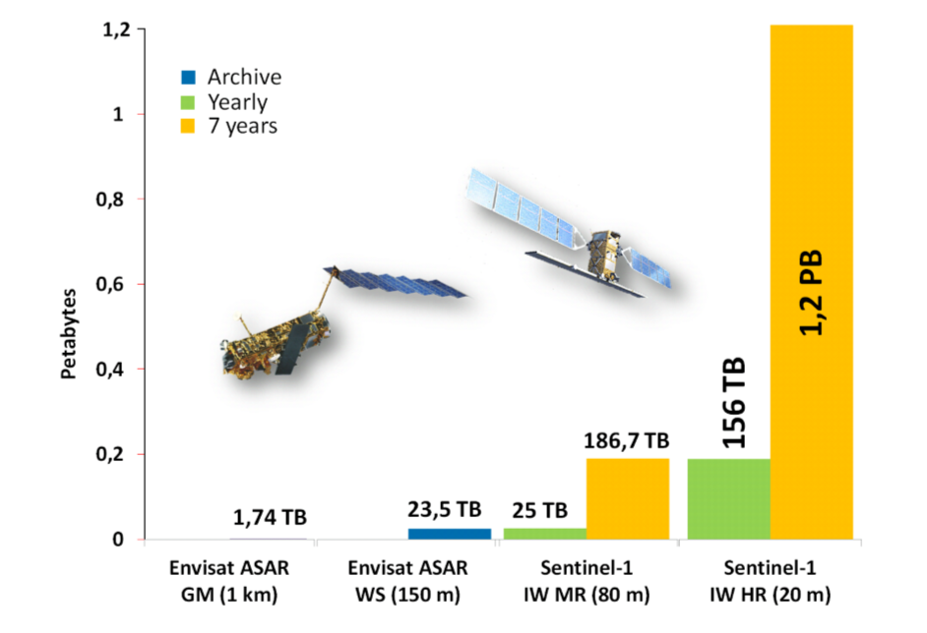
Earth Observation Data
Only ESA satellites produces around 150 terabytes per day!!
(source:https://www.esa.int/Applications/Observing_the_Earth/Working_towards_AI_and_Earth_observation )
Growth of data volume from ENVISAT ASAR to Sentinel-1.
Source: Big Data Infrastructures for Processing Sentinel Data - Wolfgang Wagner, Vienna - 2015
Notes:
Data from Space

Slide 7
Did you know that Azure has an Open Data Catalogue?
MODIS
NAIP
NOAA Global Forecast System (GFS)
Harmonized Landsat Sentinel-2
NOAA Integrated Surface Data (ISD)
Daymet
And the best part is that are FREE OF CHARGE!
https://azure.microsoft.com/en-us/services/open-datasets/catalog
Notes:
Azure has an open data catalogue with big datasets, you can find this catalogue here
https://azure.microsoft.com/en-us/services/open-datasets/catalog
Did you know that 6 from 27 (22.2%) are earth observation and every day refresh data?

Slide 8
Let’s get started
Talk with the client about the goal of the AI project.
Split the question that needs to be answered in small questions.
Search for datasets
Create the project structure.

Slide 9
You just hit the wall
The problem in every single AI project is ONE (1)
WRANGLING with the DATA.
Visualize your data

Slide 10
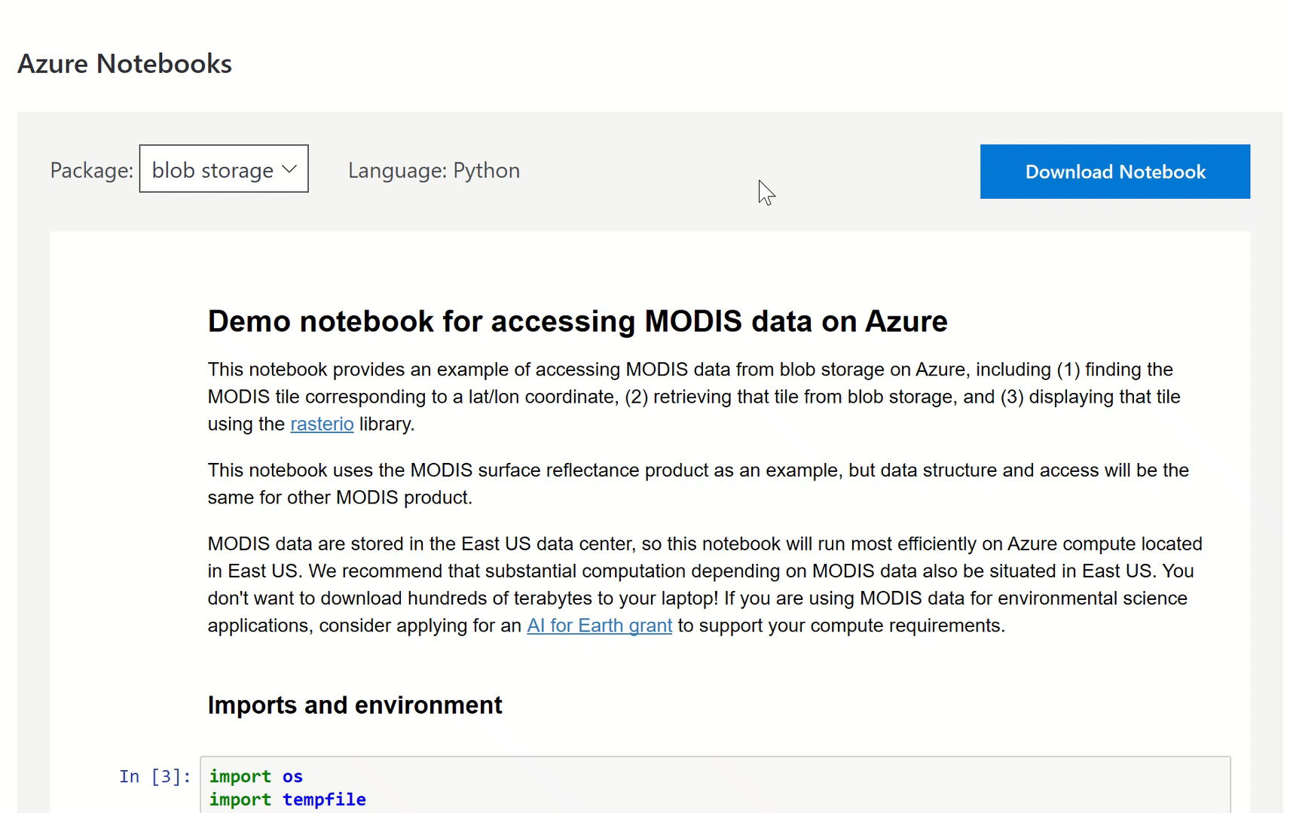
Use ready examples

Slide 11
Spatial data are special data?
Tensorflow and Pytorch are specialized Deep Learning frameworks, that are developed for specific needs. E.g. Image recognition
Things don’t go well when you try to use them outside their comfort zone.

Slide 12
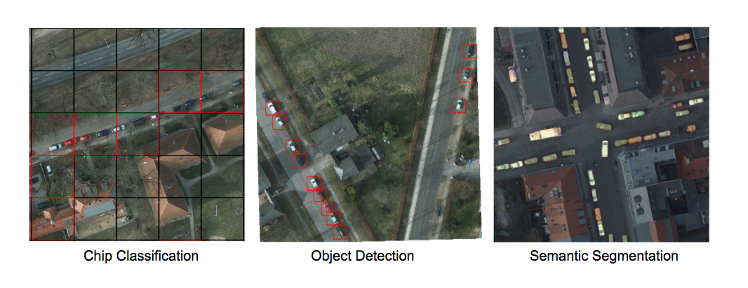
My favorite deep learning framework
Raster-Vision
https://rastervision.io/
Raster Vision is an open source framework for Python developers building computer vision models on satellite, aerial, and other large imagery sets (including oblique drone imagery)

Slide 13
Spatial Data vs Big Data
Since everything is relative:
- If you are studying (labeling) small features (e.g. roofs, cars, parking places) you are OK!!! There is nothing to worry about Big Data
If you are studying (labeling) large features (e.g. lakes, oil spills, forests)
You are in Big (Trouble) Data!!!!

Slide 14
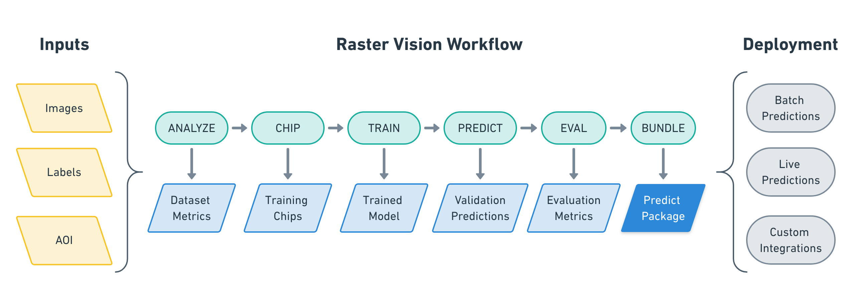
Raster-Vision workflow

Slide 15
Dockerize everything
//requirements.txt
azure azure-storage azure-storage-blob
#Dockerfile
FROM quay.io/azavea/raster-vision:pytorch-0.10 COPY requirements.txt / RUN pip install -r /requirements.txt
COPY tiny_spacenet.py ENV PATH=$PATH:/src ENV PYTHONPATH /src ADD ./ /src WORKDIR /src/

Slide 16
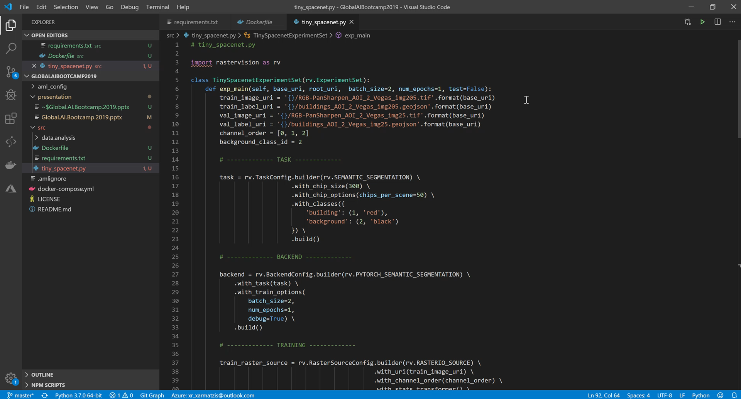
Write experiments

Slide 17
Build & run
//Build docker image
docker build -t charmatzis/raster_vision_azure_batch_demo .
//Run it
docker run charmatzis/raster_vision_azure_batch_demo python /src/tiny_spacenet.py -- base_uri
wasbs://demo@charmatzis.blob.core.windows.net/ --root_uri wasbs://demo@charmatzisdata.blob.core.windows.net/results

Slide 18
The Don’t’s
Never use Windows, always Linux
Don’t use the CPU versions, always the GPU
Never run it in your local computer.
Bonus –
4. Don’t go to your supervisor for a new Alienware laptop…. ;-)

Slide 19
If not local, then what?
Good choice (generally) Azure Machine Learning and good match with VS Code.
If you are working in special stuff (as we always do) use Azure Batch.

Slide 20
Move images to Azure with 3 simple moves
Azure Container Registry docker login athensaibootcampdemo.azurecr.io
Tag your docker container docker tag charmatzis/raster_vision_azure_batch_demo:latest athensaibootcampdemo.azurecr.io/charmatzis/ raster_vision_azure_batch_demo :latest
Upload it to ACR docker push athensaibootcampdemo.azurecr.io/ athensaibootcampdemo / raster_vision_azure_batch_demo :latest

Slide 21
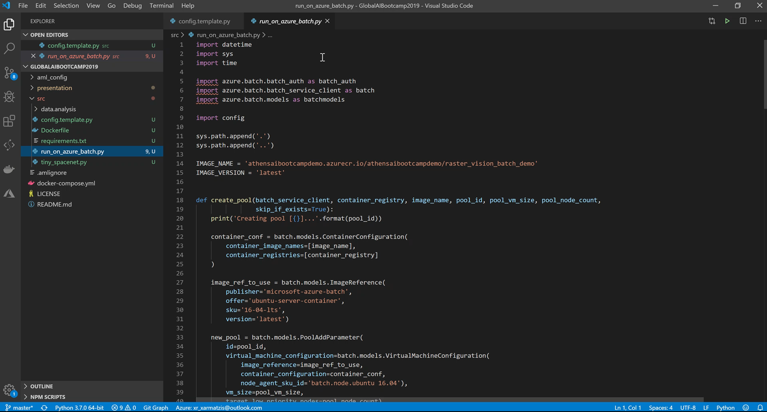
Run it on Azure Batch

Slide 22
Run it on Azure Batch… But how?
It connects to your container registry and uses those docker images
Create a Pool if it doesn’t exist yet. Here, you can configure which kind of VMs and how many of them you want in your pool. And more importantly, you can specify that it are Low Prio VMs, which are cheap.
Create a Job within the Pool
Create a separate task to process each year of data. In a real-life situation, you would have a task for each day of data.

Slide 23
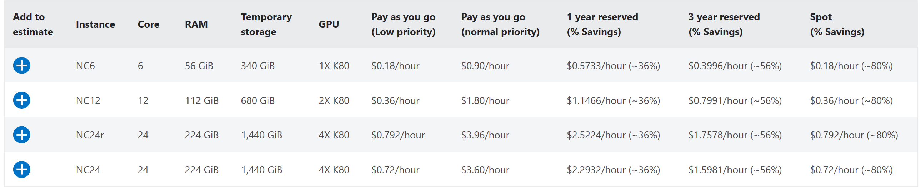
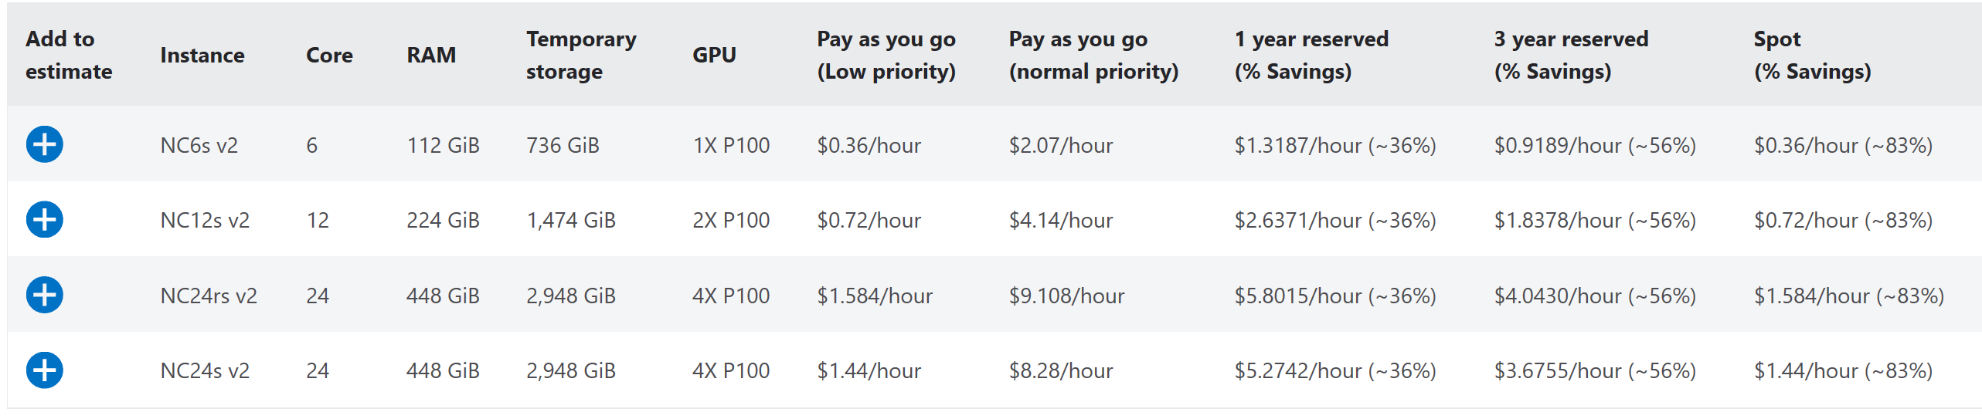
$Pricing$
NC-series
NCsv2-series
https://azure.microsoft.com/en-us/pricing/details/batch/
Notes:
Low-priority VMs and Spot VMs
Azure Batch has supported low-priority VMs since 2017, but is being updated to support spot VMs. Spot VMs are very similar to low-priority VMs, but instead of a fixed price, the price can vary and a maximum price can optionally be specified to limit the price paid for spot VMs.

Slide 24
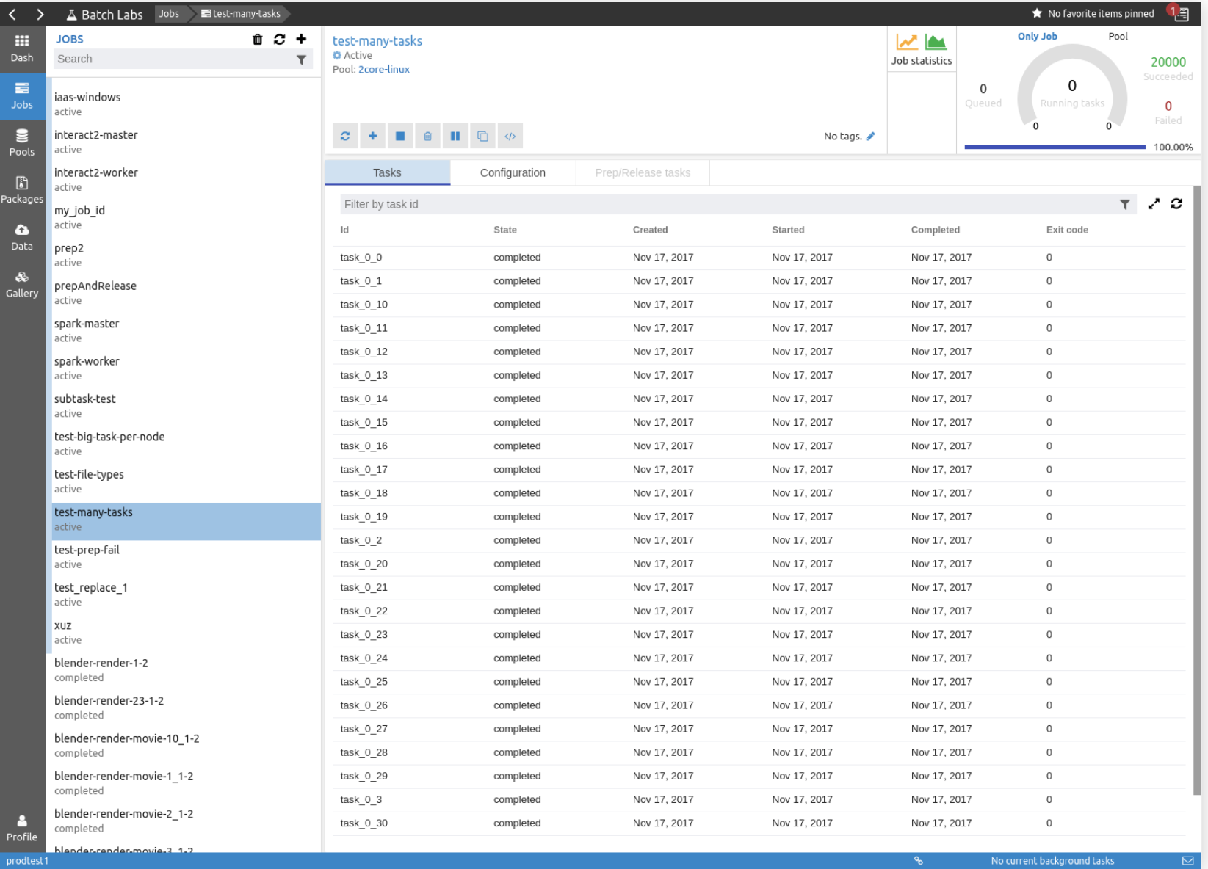
How can I monitor my Batch?

Slide 25
Conclusions
If you have normal experiments, use Azure Machine Learning
If you are working in some crazy stuff go straight to Azure Batch using containers.
Never, use your laptop for deep learning…

Slide 26
Thank U & Questions

